Slide 1

College of Computer and Information Sciences
Department of Computer Science
CSC 220: Computer Organization
Unit 12
CPU programming

Slide 2
Instruction set architectures
Last time we built a simple, but complete, datapath.
The datapath is ultimately controlled by a programmer, so today we’ll look at several aspects of this programming in more detail.
How programs are executed on processors
An introduction to instruction set architectures
Example instructions and programs
Next, we’ll see how programs are encoded in a processor. Following that, we’ll finish our processor by designing a control unit, which converts our programs into signals for the datapath.

Slide 3
Programming and CPUs

Slide 4
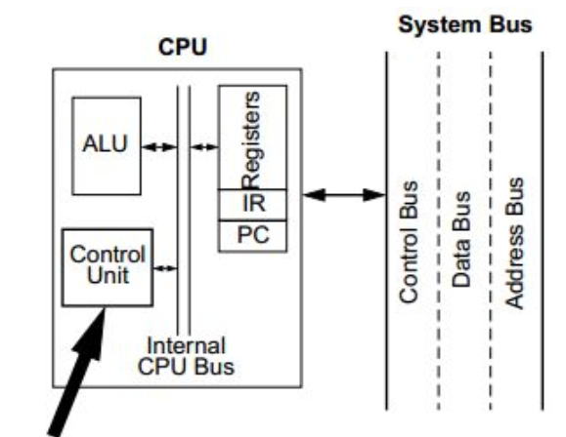
Control units
From these examples, you can see that different actions are performed when we provide different inputs for the datapath control signals.
The second question we had was “Who exactly decides which registers are read and written and which ALU function is executed?”
In real computers, the datapath actions are determined by the program that’s loaded and running.
A control unit is responsible for generating the correct control signals for a datapath, based on the program code.
We’ll talk about programs and control units next week.

Slide 5
Programming and CPUs
Programs written in a high-level language like C++ must be compiled to produce an executable program.
The result is a CPU-specific machine language program. This can be loaded into memory and executed by the processor.
CS231 focuses on stuff below the dotted blue line, but machine language serves as the interface between hardware and software.
High-level program
Compiler
Executable file
Software
Hardware
Control Unit
Control words
Datapath

Slide 6
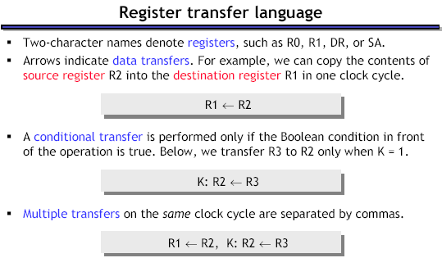

Slide 7
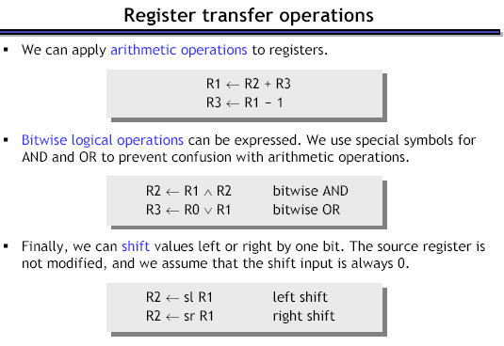

Slide 8
Memory
While memory transfers are similar to register transfers, we usually identify them differently. Specifically, memory to register transfers are called read operations, while register to memory transfers are called write operations. Both require specification of the memory location to be used (which can be done through a special register or a special bus) and a storage location which will hold the result of a read or which holds the data to be written.

Slide 9


RTL expressions for a Read operation, assuming the use of an address registers:
RTL expressions for a Write operation, assuming use of a data register:

Slide 10
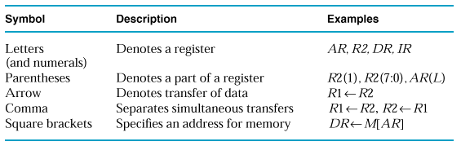
Register to Memory Transfers are denoted using square brackets surrounding the memory address.
e.g. DR ← M[AR] (Read operation)
e.g. M[AR] ← DR (Write operation)

Slide 11
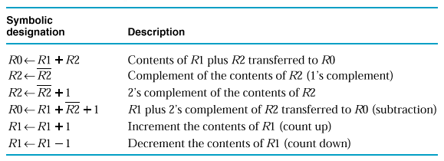
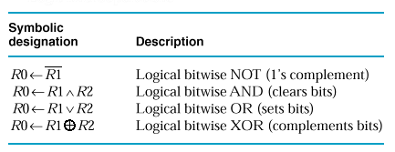
Examples of Arithmetic Microoperations
Examples of Logic Microoperations

Slide 12

Assembly and machine languages
Machine language instructions are sequences of bits in a specific order.
To make things simpler, people typically use assembly language.
We assign “mnemonic” names to operations and operands.
There is (almost) a one-to-one correspondence between these mnemonics and machine instructions, so it is very easy to convert assembly programs to machine language.
We’ll use assembly code this today to introduce the basic ideas, and switch to machine language next time.

Slide 13
Data manipulation instructions
Data manipulation instructions correspond to ALU operations.
For example, here is a possible addition instruction, and its equivalent using our register transfer notation:
This is similar to a high-level programming statement like
R0 = R1 + R2
Here, all of the operands are registers.
operation
operands
Register transfer instruction:
ADD R0, R1, R2
R0 ← R1 + R2
destination
sources

Slide 14
More data manipulation instructions
Here are some other kinds of data manipulation instructions.
NOT R0, R1 R0 ← R1’
ADD R3, R3, #1 R3 ← R3 + 1
SUB R1, R2, #5 R1 ← R2 - 5
Some instructions, like the NOT, have only one operand.
In addition to register operands, constant operands like 1 and 5 are also possible. Constants are denoted with a hash mark in front.

Slide 15
Relation to the datapath
These instructions reflect the design of our datapath from last week.
There are at most two source operands in each instruction, since our ALU has just two inputs.
The two sources can be two registers, or one register and one constant.
More complex operations like
R0 ← R1 + R2 - 3
must be broken down into several lower-level instructions.
Instructions have just one destination operand, which must be a register.
D data
WR
Write
DA
D address
Register File
AA
A address
B address
BA
A data
B data
Constant
MB
S D1 D0
Q
A
B
FS
FS
V
ALU
C
N
Z
F

Slide 16
What about RAM?
Recall that our ALU has direct access only to the register file.
RAM contents must be copied to the registers before they can be used as ALU operands.
Similarly, ALU results must go through the registers before they can be stored into memory.
We rely on data movement instructions to transfer data between the RAM and the register file.
D data
WR
Write
DA
D address
Register File
AA
A address
B address
BA
A data
B data
Constant
MB
S D1 D0
Q
RAM
ADRS
DATA
OUT
+5V
CS
A
B
MW
WR
FS
FS
V
ALU
C
N
Z
F
D0
Q D1
S
MD

Slide 17
Loading a register from RAM
A load instruction copies data from a RAM address to one of the registers.
LD R1,(R3) R1 ← M[R3]
Remember in our datapath, the RAM address must come from one of the registers—in the example above, R3.
The parentheses help show which register operand holds the memory address.
D data
WR
Write
DA
D address
Register File
AA
A address
B address
BA
A data
B data
Constant
MB
S D1 D0
Q
RAM
ADRS
DATA
OUT
+5V
CS
A
B
MW
WR
FS
FS
V
ALU
C
N
Z
F
D0
Q D1
S
MD

Slide 18
Storing a register to RAM
A store instruction copies data from a register to an address in RAM.
ST (R3),R1 M[R3] ← R1
One register specifies the RAM address to write to—in the example above, R3.
The other operand specifies the actual data to be stored into RAM—R1 above.
D data
WR
Write
DA
D address
Register File
AA
A address
B address
BA
A data
B data
Constant
MB
S D1 D0
Q
RAM
ADRS
DATA
OUT
+5V
CS
A
B
MW
WR
FS
FS
V
ALU
C
N
Z
F
D0
Q D1
S
MD

Slide 19
Loading a register with a constant
With our datapath, it’s also possible to load a constant into the register file:
LD R1, #0 R1 ← 0
Our example ALU has a “transfer B” operation (FS=10000) which lets us pass a constant up to the register file.
This gives us an easy way to initialize registers.
D data
WR
Write
DA
D address
Register File
AA
A address
B address
BA
A data
B data
Constant
MB
S D1 D0
Q
RAM
ADRS
DATA
OUT
+5V
CS
A
B
MW
WR
FS
FS
V
ALU
C
N
Z
F
D0
Q D1
S
MD

Slide 20
Storing a constant to RAM
And you can store a constant value directly to RAM too:
ST (R3), #0 M[R3] ← 0
This provides an easy way to initialize memory contents.
D data
WR
Write
DA
D address
Register File
AA
A address
B address
BA
A data
B data
Constant
MB
S D1 D0
Q
RAM
ADRS
DATA
OUT
+5V
CS
A
B
MW
WR
FS
FS
V
ALU
C
N
Z
F
D0
Q D1
S
MD

Slide 21
The # and ( ) are important!
We’ve seen several statements containing the # or ( ) symbols. These are ways of specifying different addressing modes.
The addressing mode we use determines which data are actually used as operands:
The design of our datapath determines which addressing modes we can use.
The second example above wouldn’t work in our datapath. Why not?
We’ll talk about addressing modes in more detail next lecture.
LD R0, #1000 // R0 ← 1000
LD R0, 1000 // R0 ← M[1000]
LD R3, R0 // R3 ← R0
LD R3, (R0) // R3 ← M[R0]

Slide 22
A small example
Here’s an example register-transfer operation.
M[1000] ← M[1000] + 1
This is the assembly-language equivalent:
An awful lot of assembly instructions are needed!
For instance, we have to load the memory address 1000 into a register first, and then use that register to access the RAM.
This is due to our relatively simple datapath design, which only allows register and constant operands to the ALU.
Later on, mostly in CS232, you’ll see why this can be a good thing.
LD R0, #1000 // R0 ← 1000
LD R3, (R0) // R3 ← M[1000]
ADD R3, R3, #1 // R3 ← R3 + 1
ST (R0), R3 // M[1000] ← R3

Slide 23
Control flow instructions
Programs consist of a lot of sequential instructions, which are meant to be executed one after another.
Thus, programs are stored in memory so that:
Each program instruction occupies one address.
Instructions are stored one after another.
A program counter (PC) keeps track of the current instruction address.
Ordinarily, the PC just increments after executing each instruction.
But sometimes we need to change this normal sequential behavior, with special control flow instructions.
768: LD R0, #1000 // R0 ← 1000
769: LD R3, (R0) // R3 ← M[1000]
770: ADD R3, R3, #1 // R3 ← R3 + 1
771: ST (R0), R3 // M[1000] ← R3

Slide 24
Instruction encoding
We’ve already seen some important aspects of processor design.
A datapath contains an ALU, registers and memory.
Programmers and compilers use instruction sets to issue commands.
Now let’s complete our processor with a control unit that converts assembly language instructions into datapath signals.
Today we’ll see how control units fit into the big picture, and how assembly instructions can be represented in a binary format.
On Wednesday we’ll show all of the implementation details for our sample datapath and assembly language.

Slide 25
note
Machine language is the interface between software and processors.
High-level programs must be translated into machine language before they can be run.
There are three main categories of instructions.
Data manipulation operations, such as adding or shifting
Data transfer operations to copy data between registers and RAM
Control flow instructions to change the execution order
Instruction set architectures depend highly on the host CPU’s design.
Today we saw instructions that would be appropriate for our datapath from last week.
On Monday we’ll look at some other possibilities.

Slide 26
Instruction encoding
We’ve already seen some important aspects of processor design.
A datapath contains an ALU, registers and memory.
Programmers and compilers use instruction sets to issue commands.
Now let’s complete our processor with a control unit that converts assembly language instructions into datapath signals.
Today we’ll see how control units fit into the big picture, and how assembly instructions can be represented in a binary format.
On Wednesday we’ll show all of the implementation details for our sample datapath and assembly language.

Slide 27
Review: Datapath
Recall that our ALU has direct access only to the register file.
RAM contents must be copied to the registers before they can be used as ALU operands.
Similarly, ALU results must go through the registers before they can be stored into memory.
We rely on data movement instructions to transfer data between the RAM and the register file.
D data
WR
Write
DA
D address
Register File
AA
A address
B address
BA
A data
B data
Constant
MB
S D1 D0
Q
RAM
ADRS
DATA
OUT
+5V
CS
A
B
MW
WR
FS
FS
V
ALU
C
N
Z
F
D0
Q D1
S
MD

Slide 28
Block diagram of a processor
The control unit connects programs with the datapath.
It converts program instructions into control words for the datapath, including signals WR, DA, AA, BA, MB, FS, MW, MD.
It executes program instructions in the correct sequence.
It generates the “constant” input for the datapath.
The datapath also sends information back to the control unit. For instance, the ALU status bits V, C, N, Z can be inspected by branch instructions to alter a program’s control flow.
Program
Control signals
Control
Unit
Datapath
Status signals

Slide 29
Register format ALU operations
ADD R1, R2, R3
All register format ALU operations need the same values for the following control signals:
MB = 0, because all operands come from the register file.
MD = 0 and WR = 1, to save the ALU result back into a register.
MW = 0 since RAM is not modified.
WR
1
D
Register file
A B
DA
AA
BA
constant
1 0
Mux B
MB
0
FS
A B
ALU
G
ADRS DATA
Data RAM
OUT
V
C
N
Z
MW
0
0 1
Mux D
MD
0

Slide 30
Memory write operations
ST (R0), R1
All memory write operations need the same values for the following control signals:
MB = 0, because the data to write comes from the register file.
MD = X and WR = 0, since none of the registers are changed.
MW = 1, to update RAM.
WR
0
D
Register file
A B
DA
AA
BA
constant
1 0
Mux B
MB
0
FS
A B
ALU
G
ADRS DATA
Data RAM
OUT
V
C
N
Z
MW
1
0 1
Mux D
MD
X

